Slide 1

Intro to ML for Input Recognition
CHI Course Computational Interaction 2016
Otmar Hilliges
10 April 2017

Slide 2
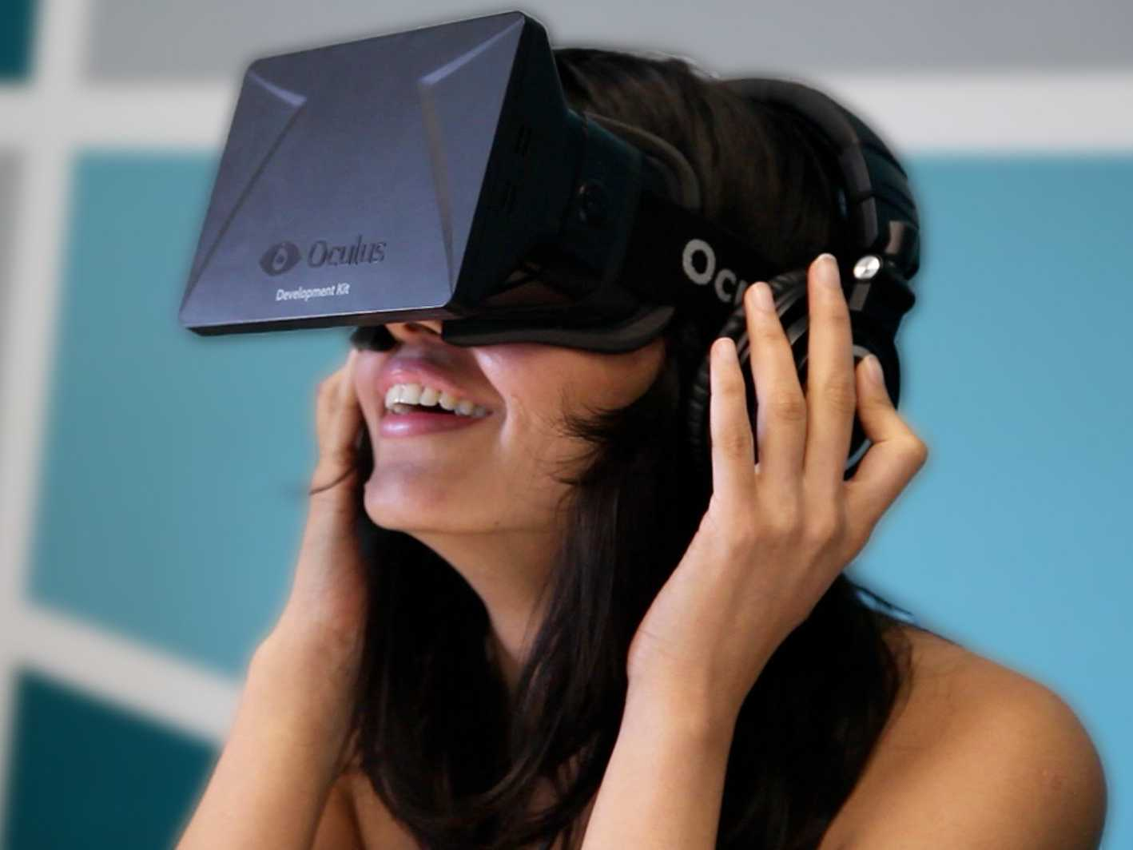
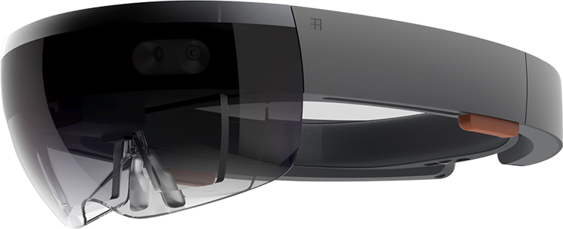
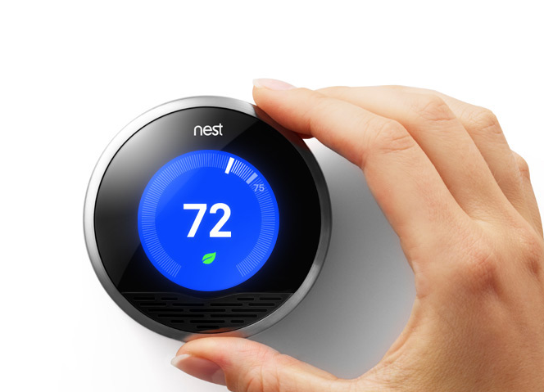
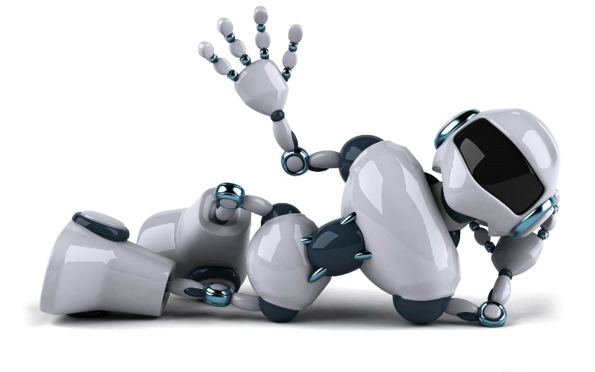
Notes:
As we are moving beyond the desktop we are already seeing multiple complementary paradigms including wearables, AR, VR.
implicit interfaces that is intelligent systems that feed of enormous amounts of sensor data and that can be proactive in interacting with us and even interact with the physical world.

Slide 3
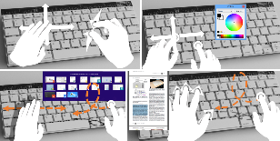
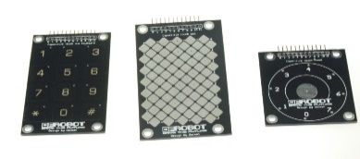
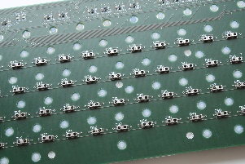
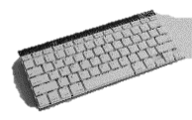
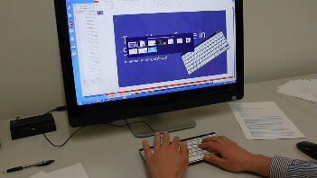

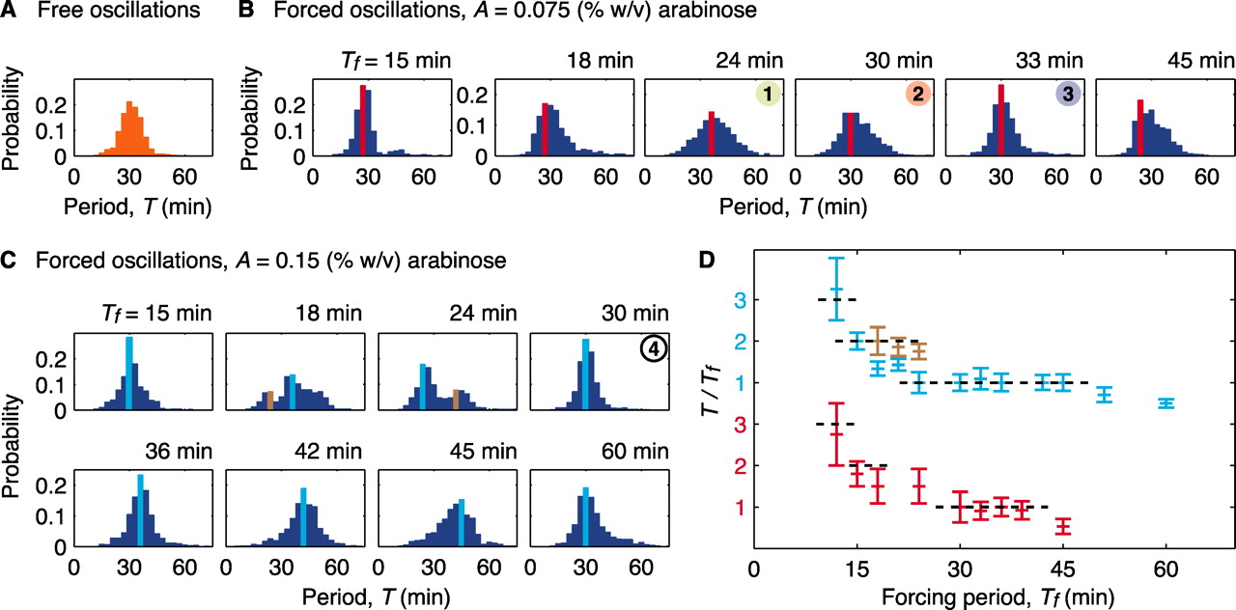

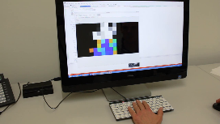
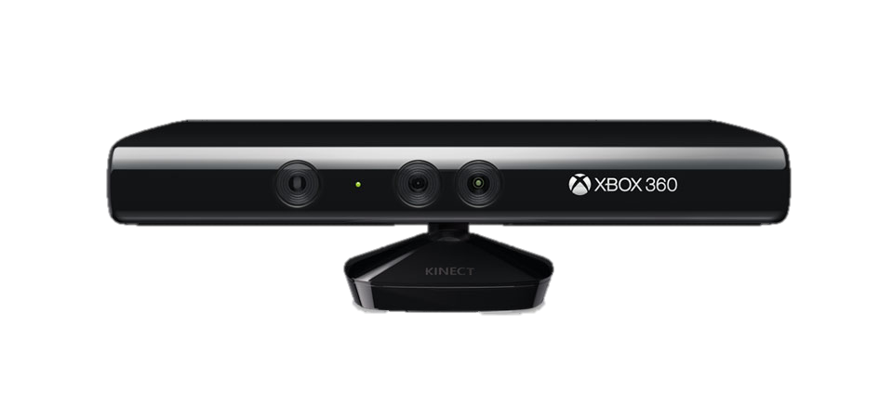

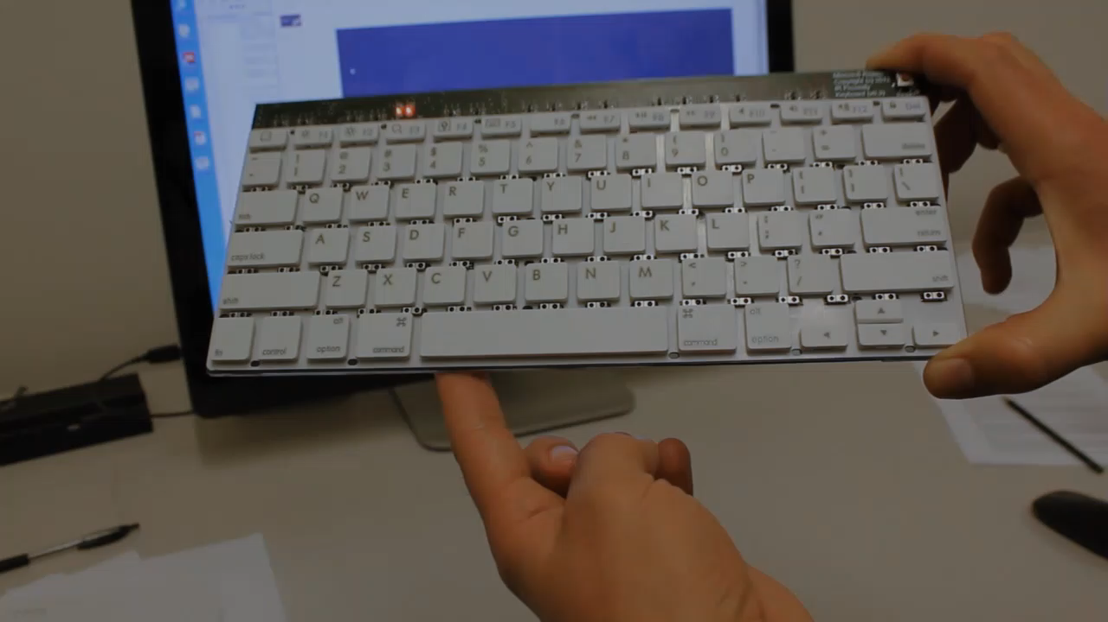
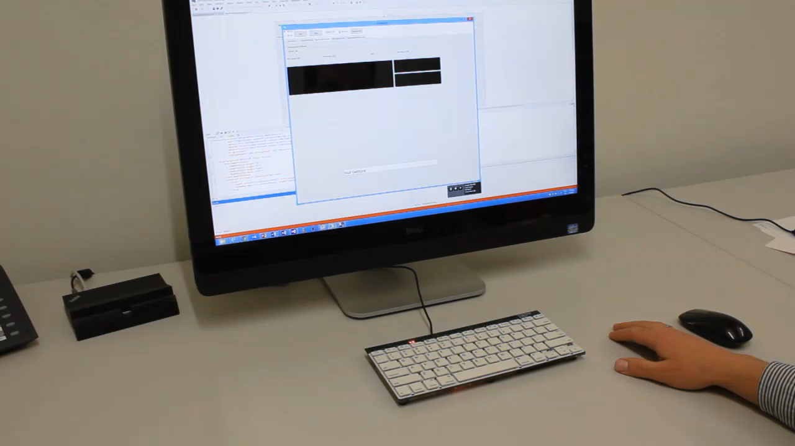
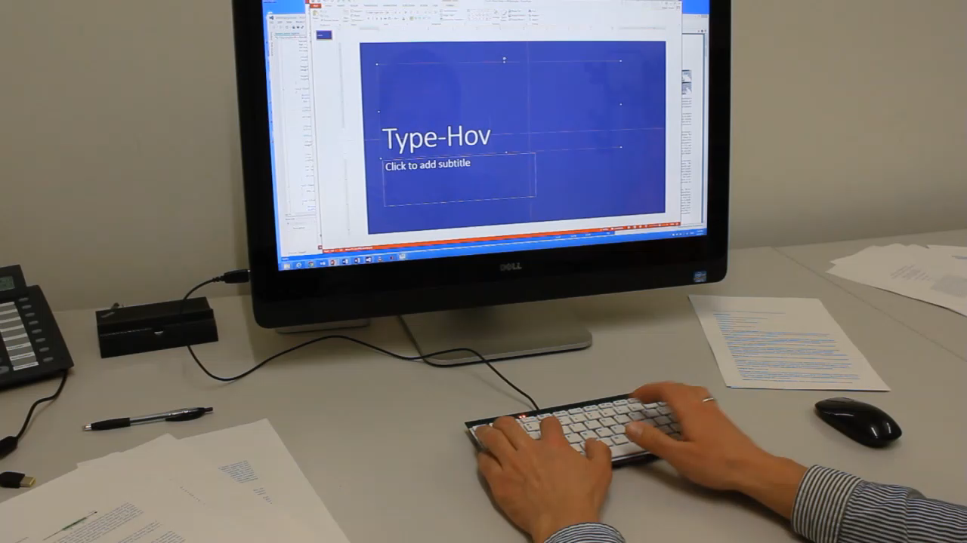
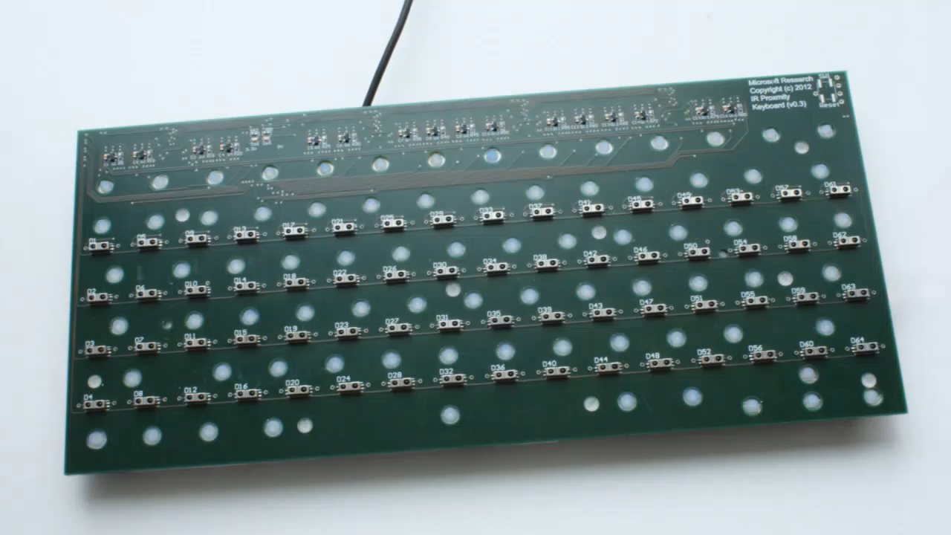

Designing Interactive Systems
Interaction Task
Sensing Technology
Sensor Placement
Input Recognition
System
Output
[Motion Sensing Keyboard. ACM CHI’14]
Notes:
To convince you let me deconstruct one of our projects – a gesture sensing, mechanical input device.
First comes the interaction task - itself a hard problem.
Then there is a huge variety of sensor technology to choose from such as internal sensors or using an overhead camera
Next, you figure out where to place these sensors, trading-off between sensing fidelity and user comfort
Once you have data you need to extract semantic meaning from it we have many choices here in terms of algorithms and their parameters
Finally, we need to decide how to actually provide feedback to the user. This could be visual, could be auditive, could be haptic
And from experience over many years I can tell you that we have to consider ALL these dimensions AND that for every project.
Now that we understand the nature of the problem…

Slide 4
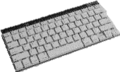
Today’s talk – Part I
Interaction Task
Sensing Technology
Sensor Configuration
Input Recognition
System
Output
Today: Machine Learning for Gesture Recognition
Notes:
To convince you let me deconstruct one of our projects – a gesture sensing, mechanical input device.
First comes the interaction task - itself a hard problem.
Then there is a huge variety of sensor technology to choose from such as internal sensors or using an overhead camera
Next, you figure out where to place these sensors, trading-off between sensing fidelity and user comfort
Once you have data you need to extract semantic meaning from it we have many choices here in terms of algorithms and their parameters
Finally, we need to decide how to actually provide feedback to the user. This could be visual, could be auditive, could be haptic
And from experience over many years I can tell you that we have to consider ALL these dimensions AND that for every project.
Now that we understand the nature of the problem…

Slide 5

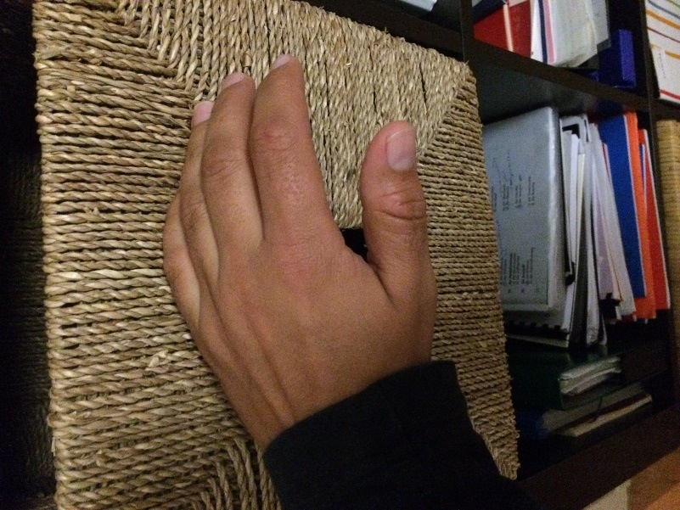
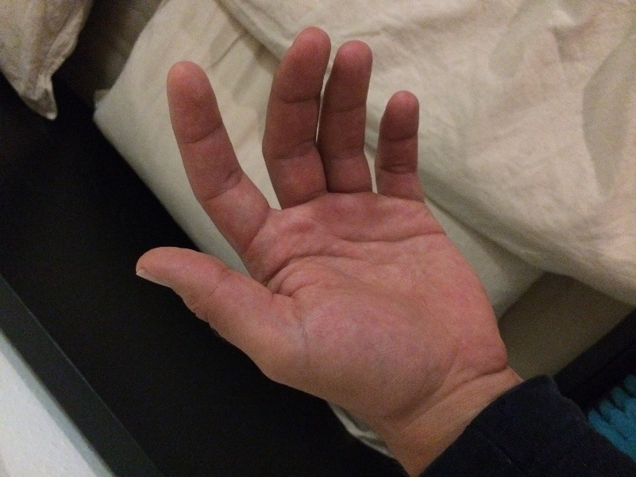

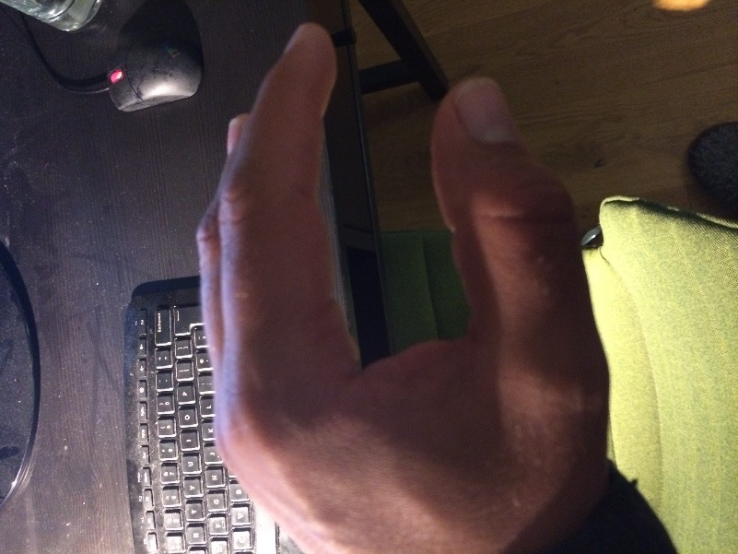
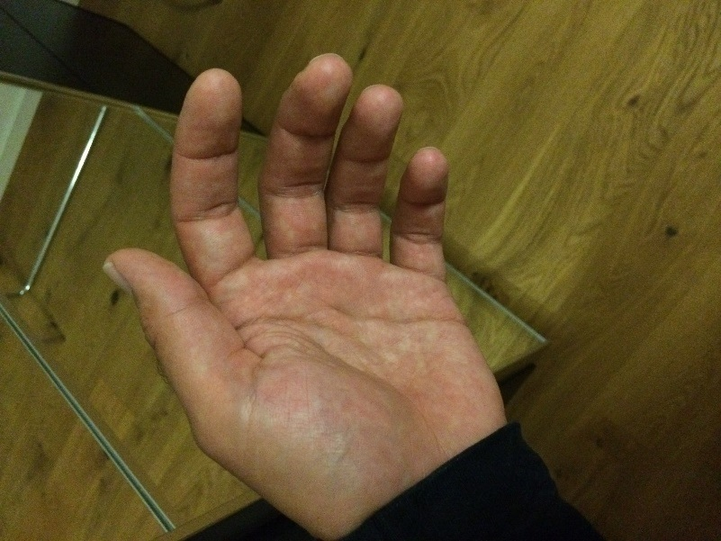
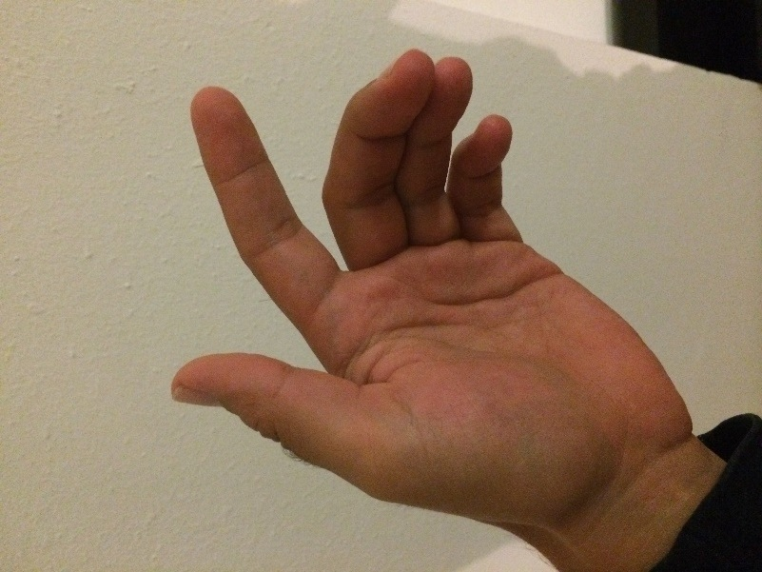
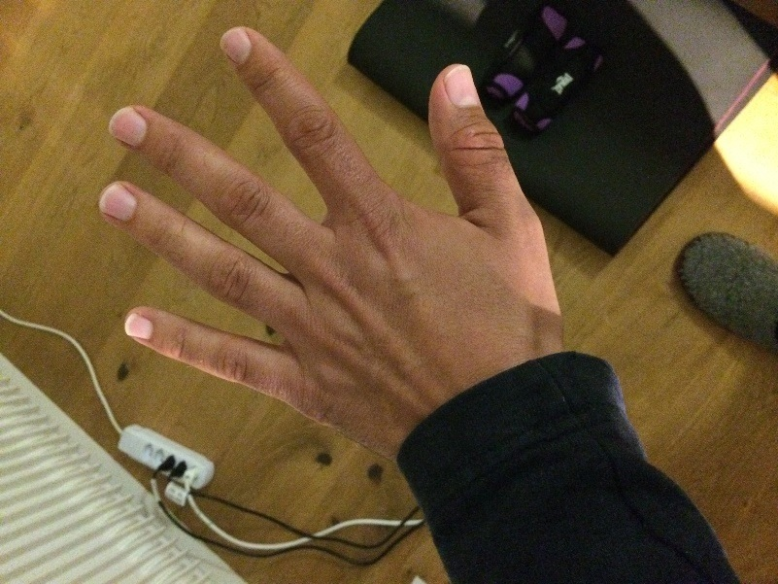
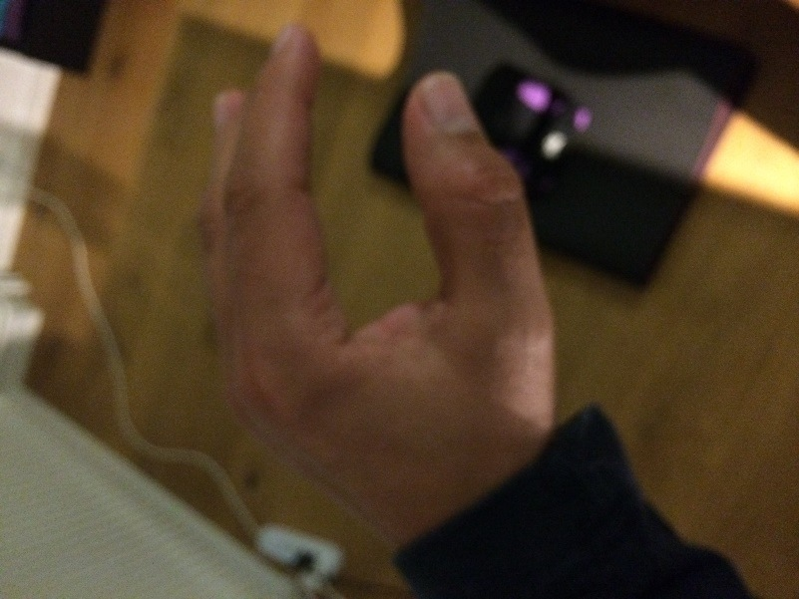
Notes:
So why is our problem so hard?
Well there are two main reasons:
<advance>
Different hands can look very different from each other
<advance>
And even a single hand can appear very differently under changing lighting or backgrounds
Hence, it is very challenging to recognize different gestures based on 2D images only.

Slide 6
Muscle-Computer Interfaces
Hands free interaction – even when holding an object
EMG or Electromyography (primarily used in medical therapy)
Action potential generated by muscle when signal arrives from motor neuron
Can be sensed non-invasively by placing electrodes on the skin
[Saponas et al., Proceedings of ACM UIST ‘09]
Notes:
The brain initiates movement process by transmitting an electrical
signal through the nervous system.
This signal stimulates the fibers that make up our muscles, which contract in
response to create forces or body movement.
EMG senses this muscular activity by measuring the electrical
potential between pairs of electrodes.yography

Slide 7
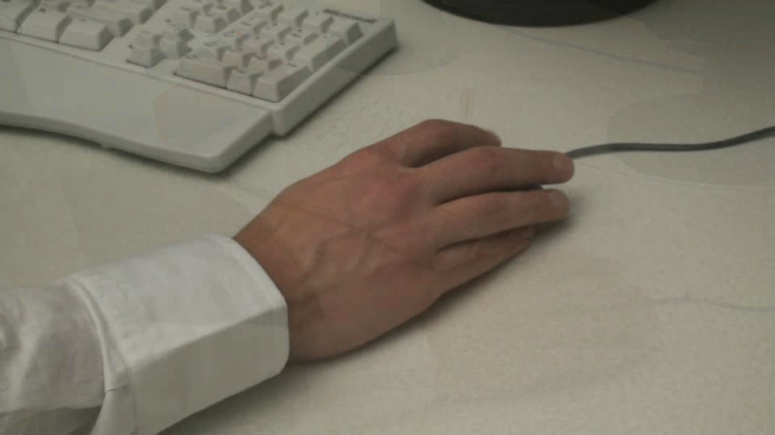
Video
[Saponas et al., Proceedings of ACM UIST ‘09]

Slide 8

Touch & Activate: Video
[Ono et al., Proceedings of ACM UIST ‘13]

Slide 9
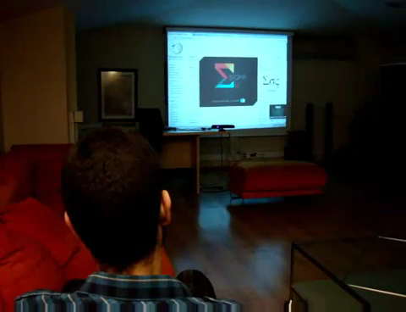
Gesture Recognition
http://www.sigmard.com/portfolio/sigmanil-framework/

Slide 10
Take Home Message
Humans use a variety of channels to interact & communicate
Human behavior is highly complex
Human behavior is highly ambiguous
Too create we intuitive interfaces we want to use:
Small, low-effort natural motion
Avoid heavy user instrumentation
In consequence,
Recognizing human input is challenging
Most heuristic / traditional approaches are not powerful enough to model the variance in (gesture) execution
Many different sensor modalities, often noisy data

Slide 11
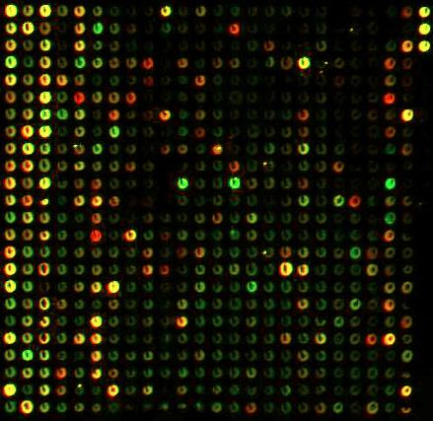
Machine Learning – Black Box View
Training data
Test-data
Magic Black Box
(learning machine)
Learned Model
Prediction
Training data:
-Positive and negative examples. Data has to be labelled (ground truth).
Model:
- The model can distinguish between classes or estimate real valued outcome.

Slide 12
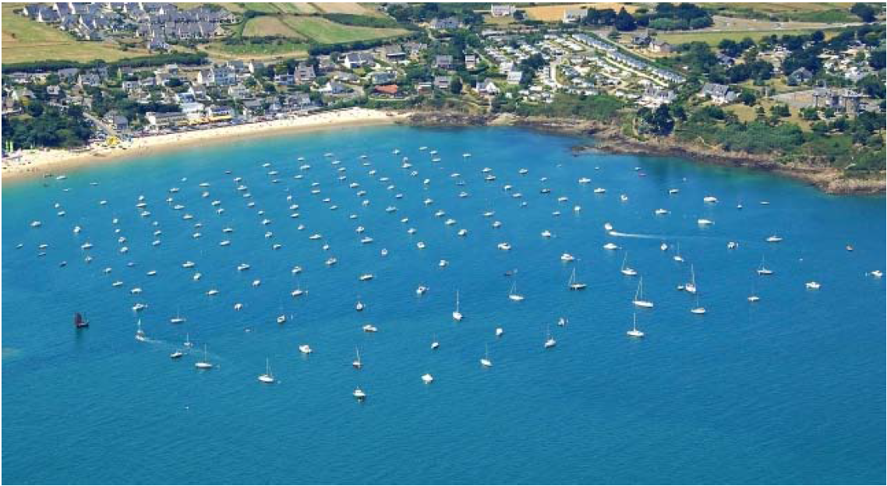
Classification: Basic Principles

Slide 13
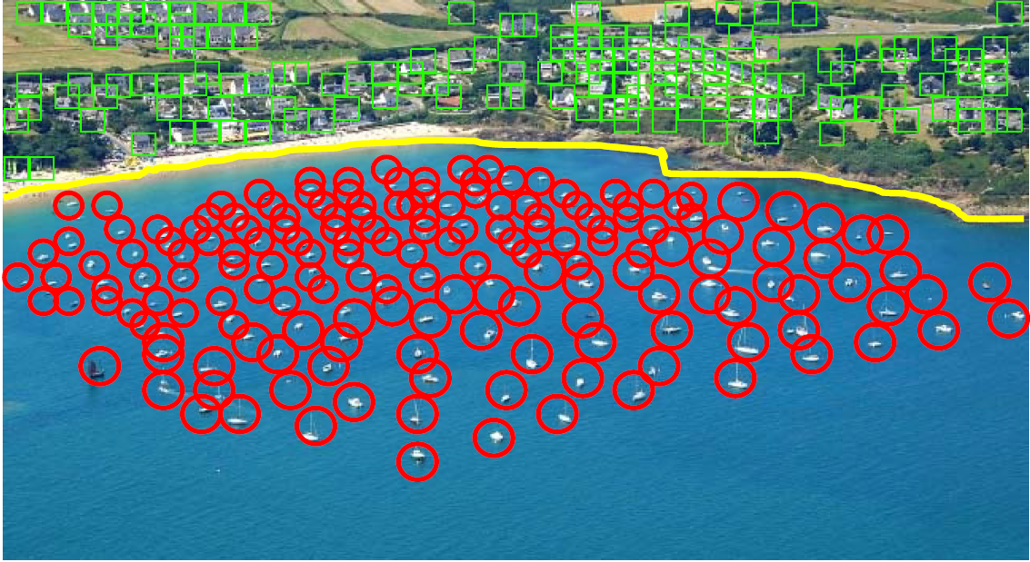
Classification: Decision Surface

Slide 14
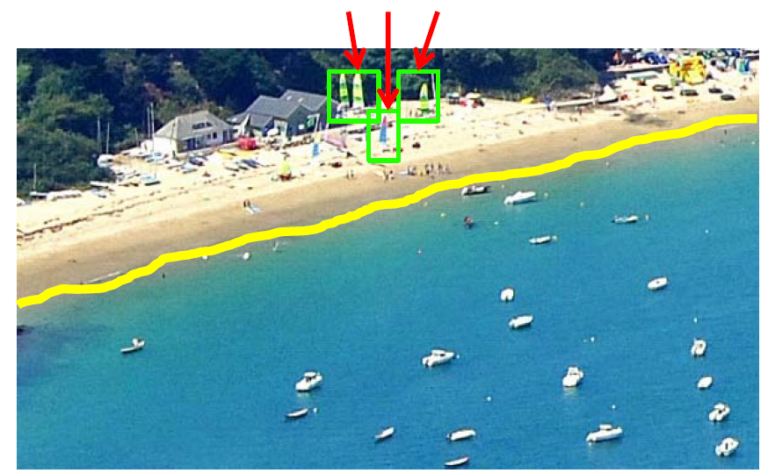
Classification: Classification Errors

Slide 15
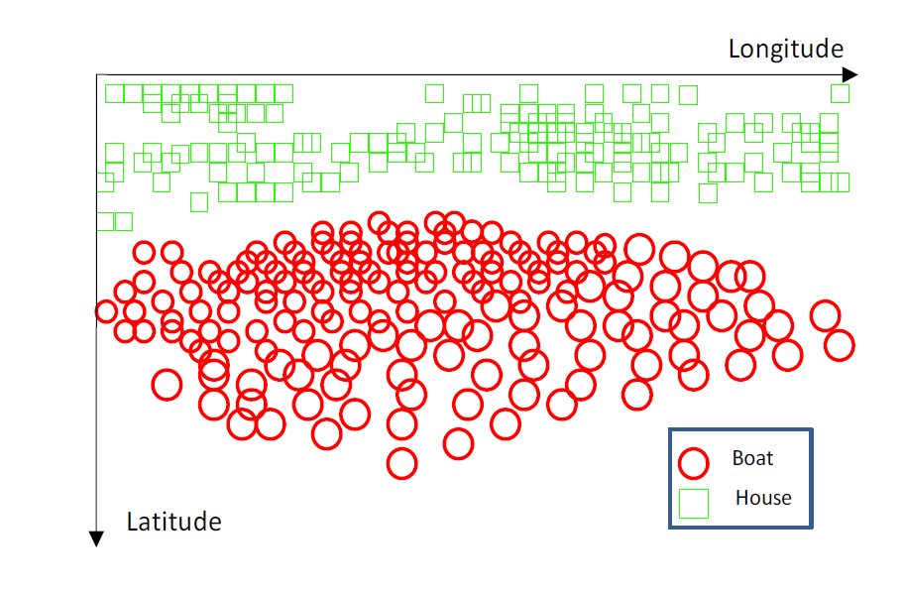
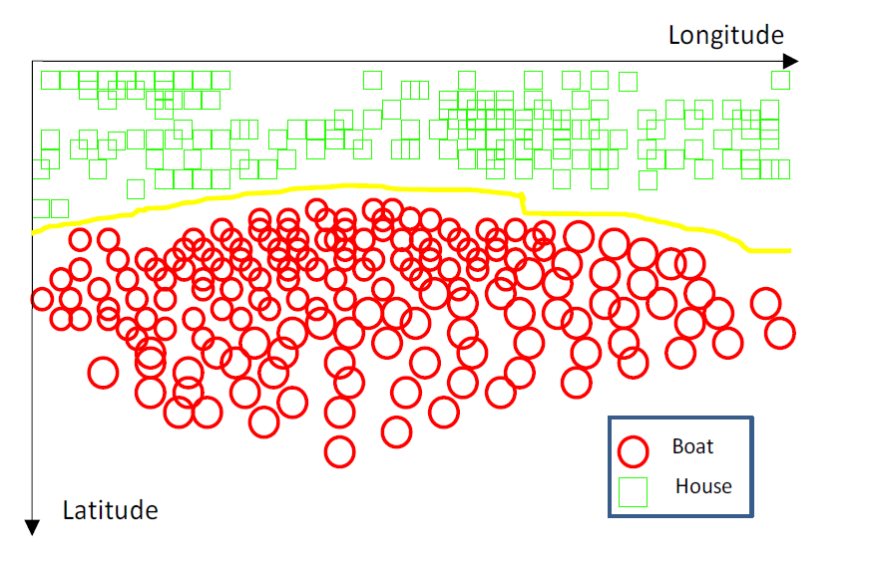
Classification Algorithms – Training time
Notes:
First all objects are represented geometrically
Then the algorithm seeks to find a decision surface that separates classes of objects
Finding the decision boundary may be costly but…

Slide 16
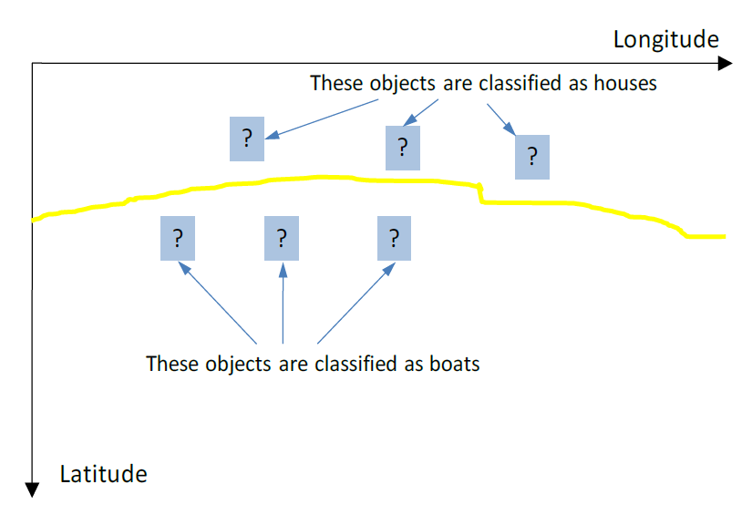
Classification Algorithms – Test time

Slide 17

[http://scikit-learn.org/stable/tutorial/machine_learning_map/index.html]

Slide 18
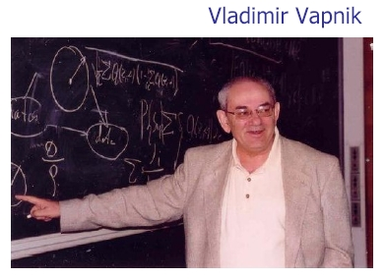
Support Vector Machine (SVM)
Derived from statistical learning theory by Vapnik, et al. in 1992
Simple SVM achieved accuracy comparable to neural-network with hand-designed features in a handwriting recognition task
SVM widely used in object detection & recognition, content-based image retrieval, text recognition, biometrics, speech recognition, etc.
Also used for regression (will not cover today)

Slide 19
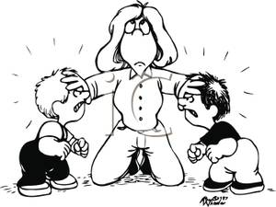

Slide 20
SVM Derivation (Intuition with some slight of hand)

Slide 21
SVM Derivation (Intuition with some slight of hand)

Slide 22
SVM Derivation (Intuition with some slight of hand)

Slide 23
SVM Derivation (Intuition with some slight of hand)

Slide 24
SVM Derivation (Intuition with some slight of hand)

Slide 25
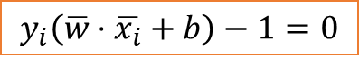
SVM Derivation (Intuition with some slight of hand)
$$y_{i}\left(\overline{w}⋅\overline{x_{i}}+b\right)−1=0$$
Notes:
This is the primal problem => It is a convex quadratic programming (QP) optimization problem but with with n variables (wi, i= 1,…,n), where n is the number of features in the dataset.
-1(w*x_+b)-1=0
-w*x_-b-1=0
-w*x_=1+b
w*x_=-1-b
=>
1-b-(-1-b)
1-b+1+b = 2

Slide 26
SVM Derivation (Intuition with some slight of hand)
$$y_{i}\left(\overline{w}⋅\overline{x_{i}}+b\right)−1=0$$
Notes:
This is the primal problem => It is a convex quadratic programming (QP) optimization problem but with with n variables (wi, i= 1,…,n), where n is the number of features in the dataset.
-1(w*x_+b)-1=0
-w*x_-b-1=0
-w*x_=1+b
w*x_=-1-b
=>
1-b-(-1-b)
1-b+1+b = 2

Slide 27
SVM Derivation (Intuition with some slight of hand)
$$y_{i}\left(\overline{w}⋅\overline{x_{i}}+b\right)−1=0$$
Notes:
This is the primal problem => It is a convex quadratic programming (QP) optimization problem but with with n variables (wi, i= 1,…,n), where n is the number of features in the dataset.
-1(w*x_+b)-1=0
-w*x_-b-1=0
-w*x_=1+b
w*x_=-1-b
=>
1-b-(-1-b)
1-b+1+b = 2

Slide 28
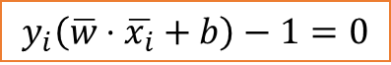
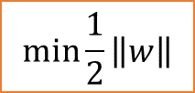
SVM Derivation (Intuition with some slight of hand)
$$y_{i}\left(\overline{w}⋅\overline{x_{i}}+b\right)−1=0$$
$$\min{\frac{1}{2}}\left\|w\right\|$$
Notes:
Lagrange multipliers: if we want to find the extrema of a function with constraints then we can use Lagrange multipliers for each constraint
Which will give us a new expression that allows us to max or min without worrying about the constraints
Second part is sum of constraints each with the Lagrange multiplier alpha
If we want to find extrema then we need to set the derivative to zero

Slide 29
SVM Derivation (Intuition with some slight of hand)
$$y_{i}\left(\overline{w}⋅\overline{x_{i}}+b\right)−1=0$$
$$\min{\frac{1}{2}}\left\|w\right\|$$
Notes:
The Lagrangian dual problem is obtained by forming the Lagrangian, using nonnegative Lagrange multipliers to add the constraints to the objective function, and then solving for some primal variable values that minimize the Lagrangian. This solution gives the primal variables as functions of the Lagrange multipliers, which are called dual variables,
Lagrange multipliers: if we want to find the extrema of a function with constraints then we can use Lagrange multipliers for each constraint
Which will give us a new expression that allows us to max or min without worrying about the constraints
Second part is sum of constraints each with the Lagrange multiplier alpha
If we want to find extrema then we need to set the derivative to zero

Slide 30
SVM Derivation (Intuition with some slight of hand)

Slide 31
SVM Derivation (Intuition with some slight of hand)

Slide 32
The Optimization Problem Solution
The solution has the form:
Each non-zero α_{i} indicates that corresponding x_{i} is a support vector.
Then the classifying function will have the form:
Notice that it relies only on the dot product between the test point x and the support vectors x_{i}
Also keep in mind that solving the optimization problem involved computing the inner products x_{i}^{T}x_{j} between all pairs of training points.
w = Σα_{i}y_{i}x_{i} b= y_{k}- w^{T}x_{k} for any x_{k} such that α_{k}≠ 0
f(x) = Σα_{i}y_{i}x_{i}^{T}x + b
Notes:
Karush-Kuhn-Tucker conditions, described in all standard optimization textbooks
Number of free parameters is bounded by the number of support vectors and not by the number of variables (beneficial for high-dimensional problems).

Slide 33
Now Some Practical Issues (iPython Notebook)

Slide 34
Non-linear SVMs

Slide 35
Non-linear SVMs
Datasets that are linearly separable (with some noise) work out great:
But what are we going to do if the dataset is just too hard?
How about … mapping data to a higher-dimensional space:
0
x
0
x
x²
0
x

Slide 36
Non-linear SVMs: Feature spaces
General idea: the original feature space can always be mapped to some higher-dimensional feature space where the training set is linearly separable:
$Φ$: x →$φ$(x)
Notes:
\Phi: x->\phi(x)

Slide 37
Non-linear SVMs: The Kernel Trick
With this mapping, our discriminant function is now:
$$y\left(x\right)=w^{T}φ\left(x\right)+b=\sum_{i∈SV}{α_{i}φ{\left(x_{i}\right)}^{T}φ\left(x\right)+b}$$
No need to know mapping function $φ$explicitly, because we only use the dot product of feature vectors in both training and test.
A kernel function is defined as a function that corresponds to a inner product of two feature vectors in some expanded feature space:
Notes:
But what’s more interesting is that often, K(x, z) may be very inexpensive to calculate, even though φ(x) itself may
be very expensive to calculate (perhaps because it is an extremely high dimensional vector). In such settings, by using in our algorithm an efficient
way to calculate K(x, z), we can get SVMs to learn in the high dimensional feature space space given by φ, but without ever having to explicitly find or
represent vectors φ(x).

Slide 38
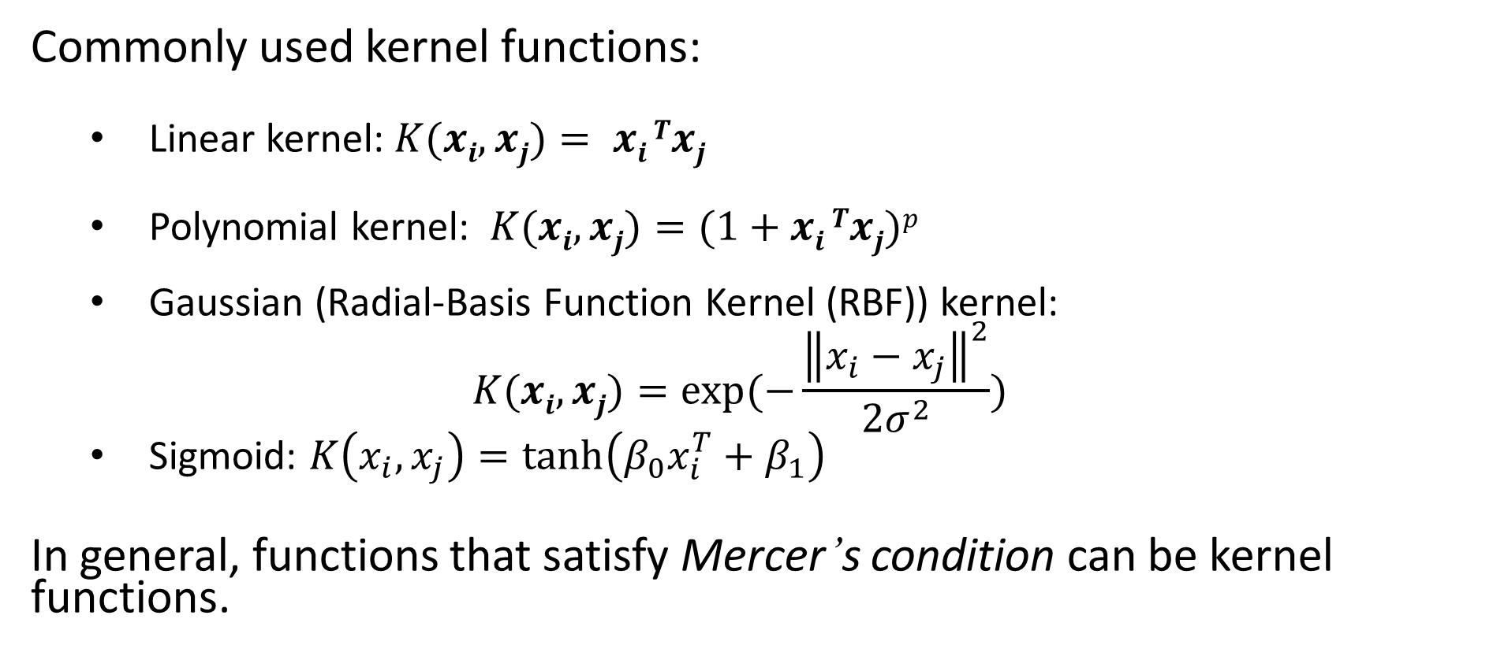
Non-linear SVMs: The Kernel Trick
Commonly used kernel functions:
Linear kernel: $K(xi,xj)= xi Txj$
Polynomial kernel: $K(xi,xj)=(1+xi Txj)p$
Gaussian (Radial-Basis Function Kernel (RBF)) kernel:
$$K(xi,xj)=exp(−\frac{{\left\|x_{i}−x_{j}\right\|}^{2}}{2σ^{2}})$$
Sigmoid: $K\left(x_{i},x_{j}\right)=\tanh\left(β_{0}x_{i}^{T}+β_{1}\right)$
In general, functions that satisfy Mercer’s condition can be kernel functions.
Notes:
Mercer’s an important theoretical tool in the theory of integral equations; it is used in the Hilbert space theory of stochastic processes, for example.
However, the general statement is more than what is required for understanding the kernel trick. Given a finite observation set X, one can select the counting measure \mu(T) = |T| for all T\in X. Then the integral in Mercer's theorem reduces to a simple summation
\sum\sum K(x_i,x_j)c_ic_j >= 0
for all finite sequences of points in (x_1,…,x_n) and all choices of real-valued coefficients (c_1,…,c_n) (cf. positive definite kernel).
Some algorithms that depend on arbitrary relationships in the native space would, in fact, have a linear interpretation in a different setting: the range space of \phi. The linear interpretation gives us insight about the algorithm. Furthermore, there is often no need to compute directly during computation, as is the case with support vector machines. Some cite this running time shortcut as the primary benefit. Researchers also use it to justify the meanings and properties of existing algorithms.

Slide 39
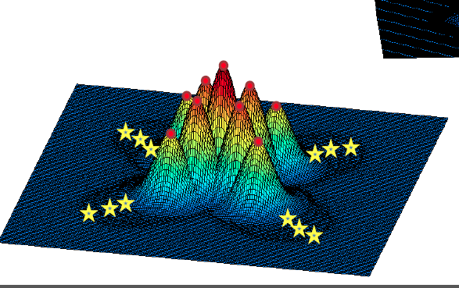
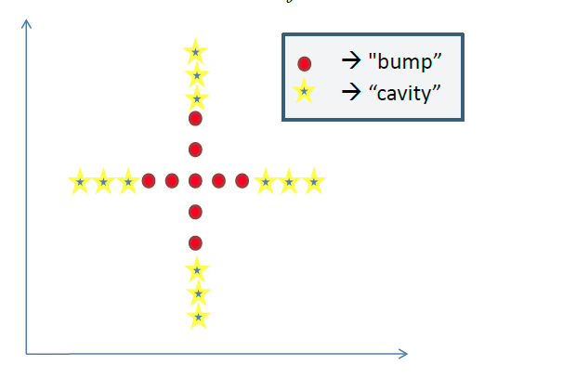
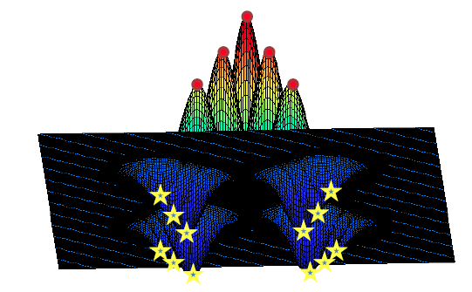
Example: Gaussian Kernel
Geometrically, this is a “bump” or “cavity” centered at the training data point x:

Slide 40
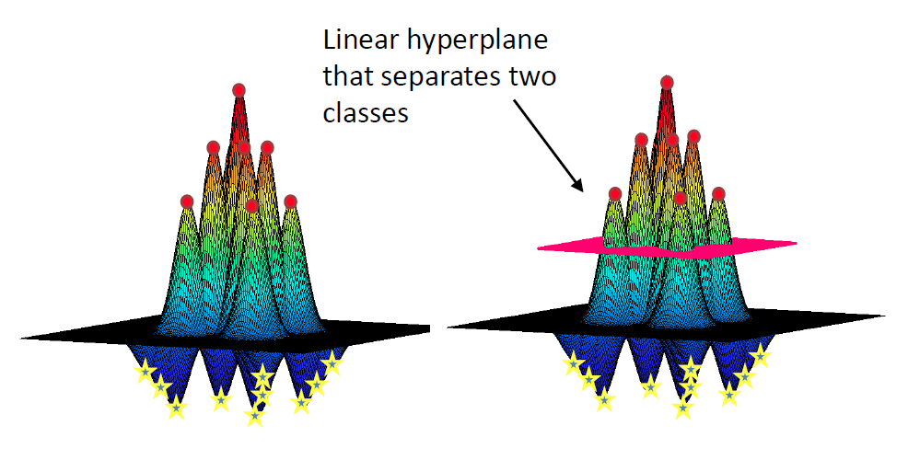
Example: Gaussian Kernel - Classification
Geometrically, this is a “bump” or “cavity” centered at the training data point x:

Slide 41
SVMs in HCI
Many software packages exist, implementing linear SVMs, kernel SVMs and more
LibSVM (http://www.csie.ntu.edu.tw/~cjlin/libsvm/)
Matlab SVM toolbox (http://www.isis.ecs.soton.ac.uk/resources/svminfo/)
Weka Data Mining toolbox (http://www.cs.waikato.ac.nz/ml/weka/index.html)
More resources:
http://www.kernel-machines.org
SVMs probably the most frequently used ML technique in HCI

Slide 42
Reading Suggestions
V. Vapnik, Statistical Learning Theory. Wiley-Interscience; 1998
Christopher M. Bishop, Pattern Recognition and Machine Learning (Information Science and Statistics), Springer-Verlag New York, Inc., Secaucus, NJ, 2006
C.J.C. Burges. A tutorial on support vector machines for pattern recognition. Data Mining and Knowledge Discovery, 2(2):955-974, 1998.
http://www.kernel-machines.org

